Slide 1

Leadership: Being an
Effective Project Manager
Business Studies Department, BUKC

Slide 2
Managing versus Leading a Project
Managing—coping with complexity
  Formulate plans and objectives
  Monitor results
  Take corrective action
  Expedite activities
  Solve technical problems
  Serve as peacemaker
  Make tradeoffs among time, costs, and project scope
Leading—coping with change
  Recognize the need to change to keep the project on track
  Initiate change
  Provide direction and motivation
  Innovate and adapt as necessary
  Integrate assigned resources

Slide 3
Managing Project Stakeholders
Project Management Maxims:
  You can’t do it all and get it all done
    Projects usually involve a vast web of relationships.
  Hands-on work is not the same as leading.
    More pressure and more involvement can reduce your effectiveness as a leader.
  What’s important to you likely isn’t as important to someone else
    Different groups have different stakes (responsibilities, agendas, and priorities) in the outcome of a project.
  Remember: project management is tough, exciting, and rewarding—endeavor to persevere.

Slide 4
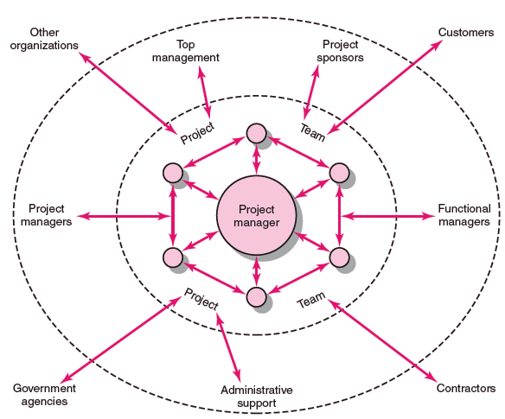
Network of Stakeholders
FIGURE 10.1

Slide 5
Influence as Exchange
The Law of Reciprocity
  One good deed deserves another, and likewise, one bad deed deserves another.
Quid pro Quo
  Mutual exchanges of resources and services (“back-scratching”) build relationships.
Influence “Currencies” (Cohen and Bradford)
  Cooperative relationships are built on the exchange of organizational “currencies” (favors).

Slide 6
Commonly Traded Organizational Currencies
Task-related currencies
  Resources Lending or giving money, budget increases, personnel, etc.
  Assistance Helping with existing projects or undertaking unwanted tasks.
  Cooperation Giving task support, providing quicker response time, or aiding implementation.
  Information Providing organizational as well as technical knowledge.
Position-related currencies
  Advancement Giving a task or assignment that can result in promotion.
  Recognition Acknowledging effort, accomplishments, or abilities.
  Visibility Providing a chance to be known by higher-ups or significant others in the organization.
  Network/contacts Providing opportunities for linking with others.
Source: Adapted from A. R. Cohen and David L. Bradford, Influence without Authority
(New York: John Wiley & Sons, 1990). Reprinted by permission of John Wiley & Sons, Inc.
TABLE 10.1

Slide 7
Commonly Traded Organizational Currencies (cont’d)
Inspiration-related currencies
  Vision Being involved in a task that has larger significance for the unit, organization, customer, or society.
  Excellence Having a chance to do important things really well.
  Ethical correctness Doing what is “right” by a higher standard than efficiency.
Relationship-related currencies
  Acceptance Providing closeness and friendship.
  Personal support Giving personal and emotional backing.
  Understanding Listening to others’ concerns and issues.
Personal-related currencies
  Challenge/learning Sharing tasks that increase skills and abilities.
  Ownership/involvement Letting others have ownership and influence.
  Gratitude Expressing appreciation.
Source: Adapted from A. R. Cohen and David L. Bradford, Influence without Authority
(New York: John Wiley & Sons, 1990). Reprinted by permission of John Wiley & Sons, Inc.
TABLE 10.1 (cont’d)

Slide 8
Management by Wandering Around (MBWA)
Management by Wandering Around (MBWA)
  A management style that involves managers spending the majority of time outside of their offices in face-to-face interactions with employees building cooperative relationships.
Characteristics of Effective Project Managers
  Initiate contact with key players.
  Anticipate potential problems.
  Provide encouragement.
  Reinforce the objectives and vision of the project.
  Intervene to resolve conflicts and prevent stalemates.

Slide 9
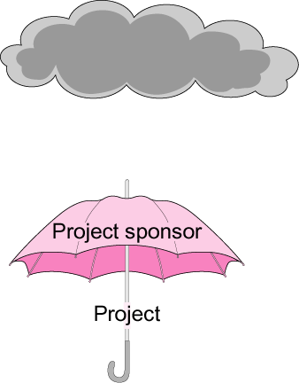
The Significance of a Project Sponsor
FIGURE 10.3

Slide 10
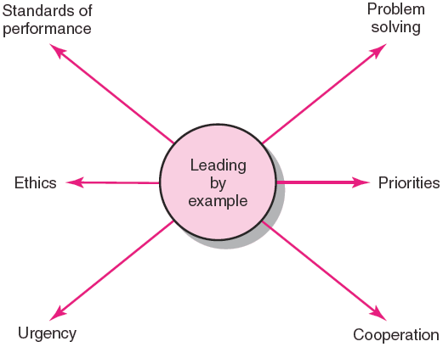
Leading by Example
FIGURE 10.4

